Slide 1

ENSE 471, Project Delivery
[Guardians]
[Xia Hua , Ali Husain, Jiwoun Kim,]
[2020-04-09]

Slide 2
Team (re)introductions
Code Head :Jiwoun Kim
Design Head:Xia Hua
Documentation :Ali Husain

Slide 3
Problem & Requirements
The fire-safety public education program by Regina Fire and Protective Services (RFPS) for elementary school has become obsolete and needed some update or change in order to cope up with the current technology and communication tools, such as line phone training system.

Slide 4
Rationale
Whenever a fire happens, it is disastrous to the community and to the people. The most important part of it is survival especially for the children who are capable to learn surviving techniques. Teaching them to learn essential survival skills in case of fire will enable them to respond appropriately in a fire emergency.

Slide 5
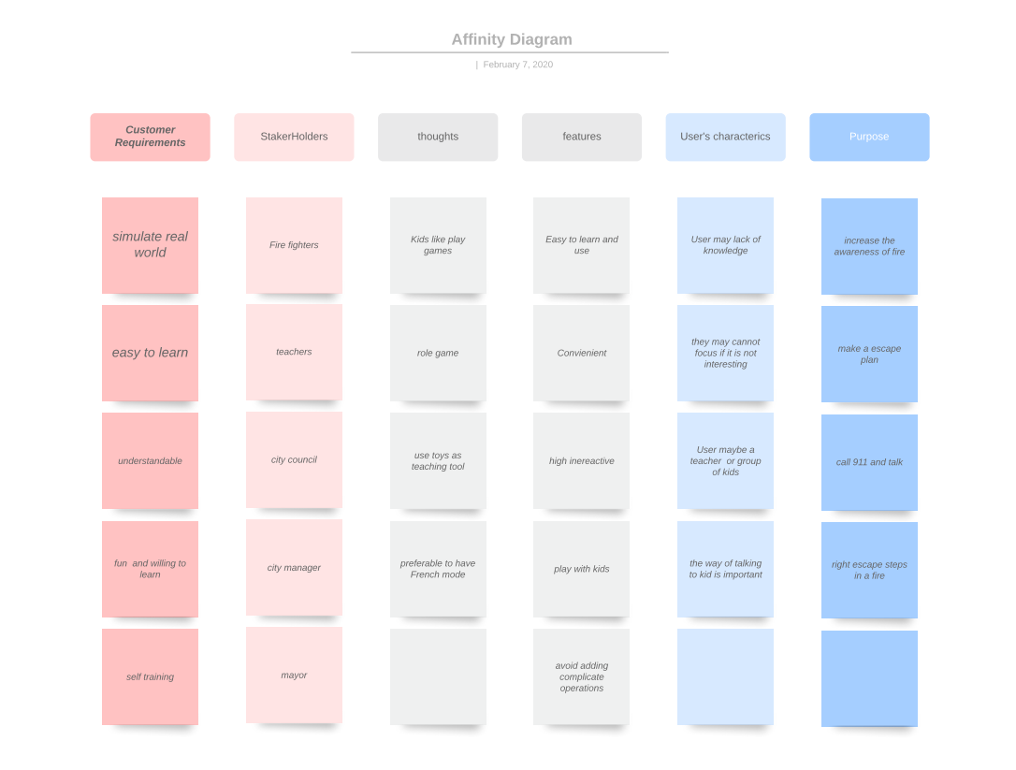

Slide 6
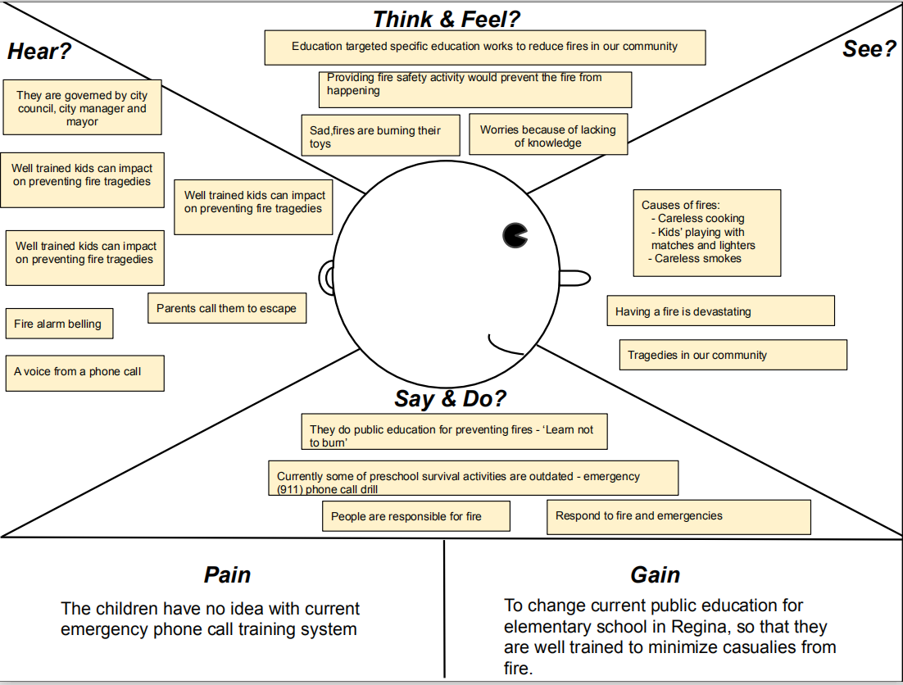

Slide 7
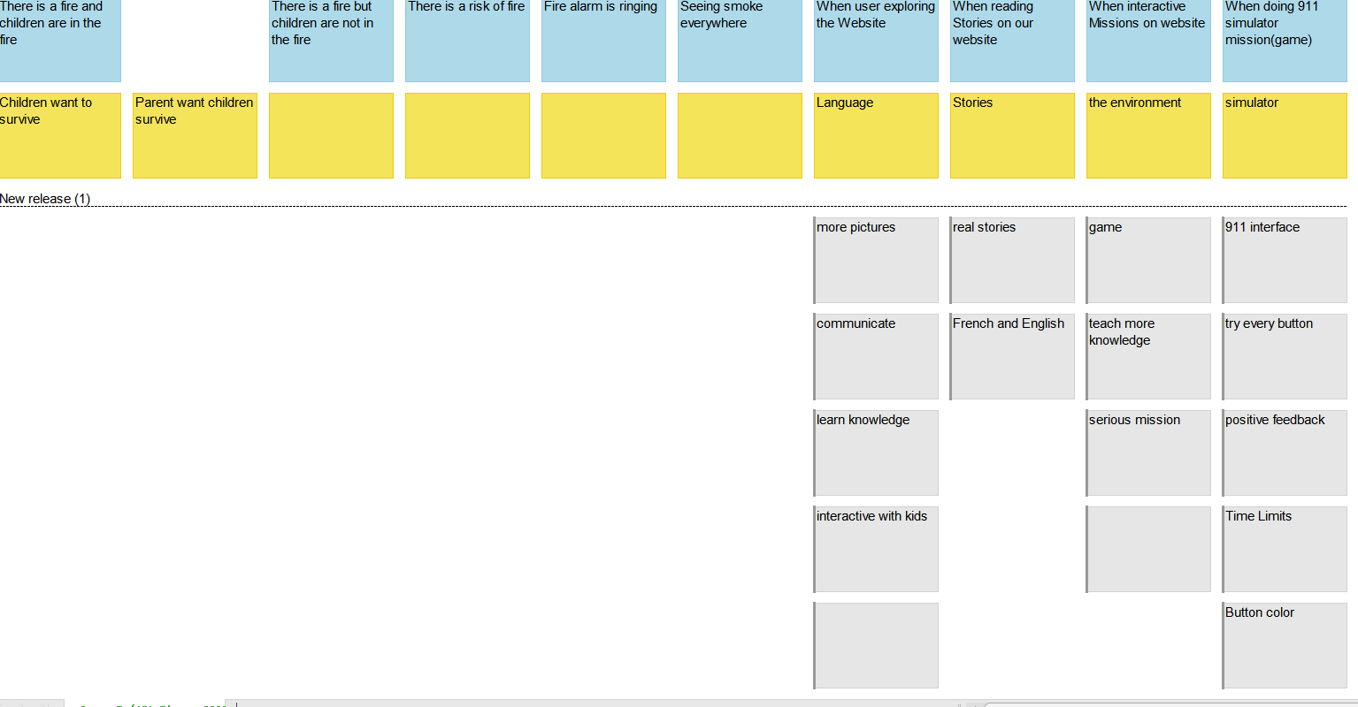
USM

Slide 8
MVP vision
Designing an interactive application for early child, which teaches them to learn various surviving skills in case of fire, such as calling 911, getting away from smoke, evacuating the place and other escape procedures for their survival.

Slide 9

Brainstorming
Ali’s Idea(s):
- It should provide instructions of various operations for e.g. how to report fire by going under which specific menu etc
- Could provide a variety of videos like how to prepare yourself in advance and and other evacuating techniques in case of fire
- Can have an option like “Deaf Emergency” for kids who are deaf or cannot speak
- A game related to fire causing incidents (which provides scenarios of what to do in case of fire) inside the app could also be a good idea in educating the children about fire safety or escape procedure.
Jiwoun’s Idea(s): - The interface should simulate a phone screen on a smartphone. Also, it should represent both iphone or android phone screen.
- Under or top of the screen somewhere, the procedure of the training is to be shown.
- English/French selection - Scenario mode(automatically begins the procedure with guide to show the whole process)
- Try mode with arrows on the phone buttons; what button should be pushed(on phone screen)
- Using real 911 dispatch voices as the training .
Xia’s Idea(s): - A handbook of guidering kids on how to escape and right things to do in a fire or daily life. Using the from of a story book
- A place for parents and other adults to communicate so they can get experience from others
- More picture and sounds less words , so that kids can focus
- Make games or missions more realistic .
- Using more symbols which kids are familiar with, such as cartoon characters , toys…
- Guiding Videos. - Interactive game : Show a picture of a certain circumstance and let players choose the right answer from multiple choice.

Slide 10
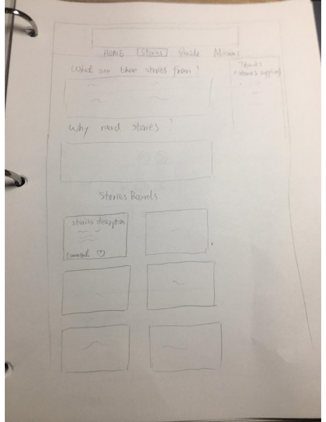
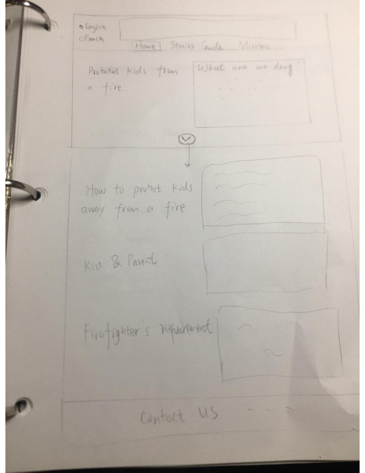
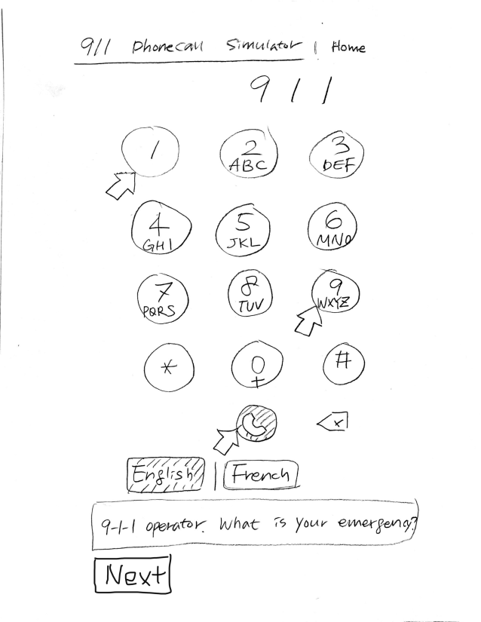
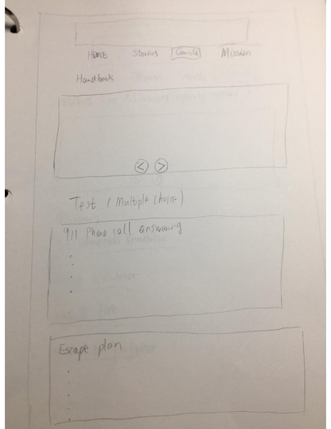
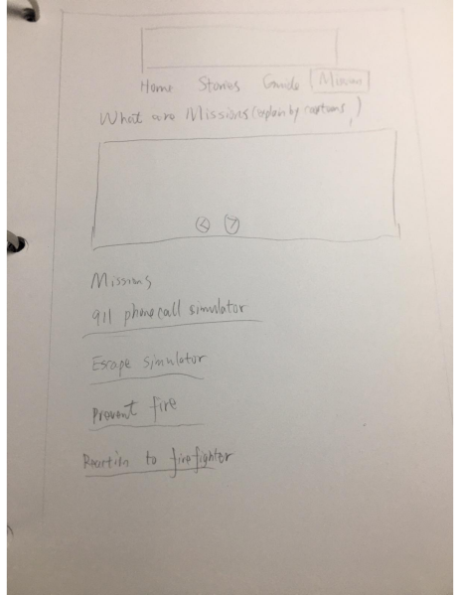
lo-fidelity prototypes

Slide 11
Hi-fidelity prototypes

Slide 12
DesignPrinciples
1.Affordances: The key pad of the phone-simulation are affordances as they afford clicking on it and then provides the range of options and information by the 911 call-operator like, “what kind of emergency, what to do/what not to do” etc.
2.Signifiers: In the phone-simulation, for dialing 911, as you press the key 9, voice of screaming children can be heard and the key pressed will appear on the screen signaling that you have press the right key. Pressing any other key like a key 4 would make a weird sound,(“something throwing forcefully” kind of sound ) and the key will not be displayed on the screen indicating that the wrong key has been pressed.
3.Constraints: One possible constraint could be the phone system constraint , there are lots of different interface of making a phone call in different phone or systems, we can only make our simulation as clear as possible so that can be general.

Slide 13
Solution demo
Do a high-level overview of your solution, including screenshots of key experiences
Demo your solution
Discuss links to lo/hi-fidelity prototypes
Discuss experiences as they relate to your team’s USM/MVP
Again, ensure you link your design ideas back to a minimum of three topics discussed in class relating to people centered design (affordances, gestalt, constraints, etc.)

Slide 14
GitHub “stamp of approval”
We approve

Slide 15
Group reflection
How did you feel about this project? What did you like about it? What did you dislike?
Great experience to work with our client Candice.
In-person meetings were beneficial in getting a feedback and keeping a track of which direction we were heading in.
It would have been better if we would have got a bit more time to complete this project.
What did you learn about yourself as you collaborated and worked through this project?
We need to continuously communicate as a group to get things done on time.
How will you use what you have learned on this project going forward?
Balance the expected needs from the different users with a focus on a small sub-set of customers.
Teamwork and Cooperation.

